Slide 1
SMART SPRINKLER SYSTEM FOR GOLF COURSE

Slide 2
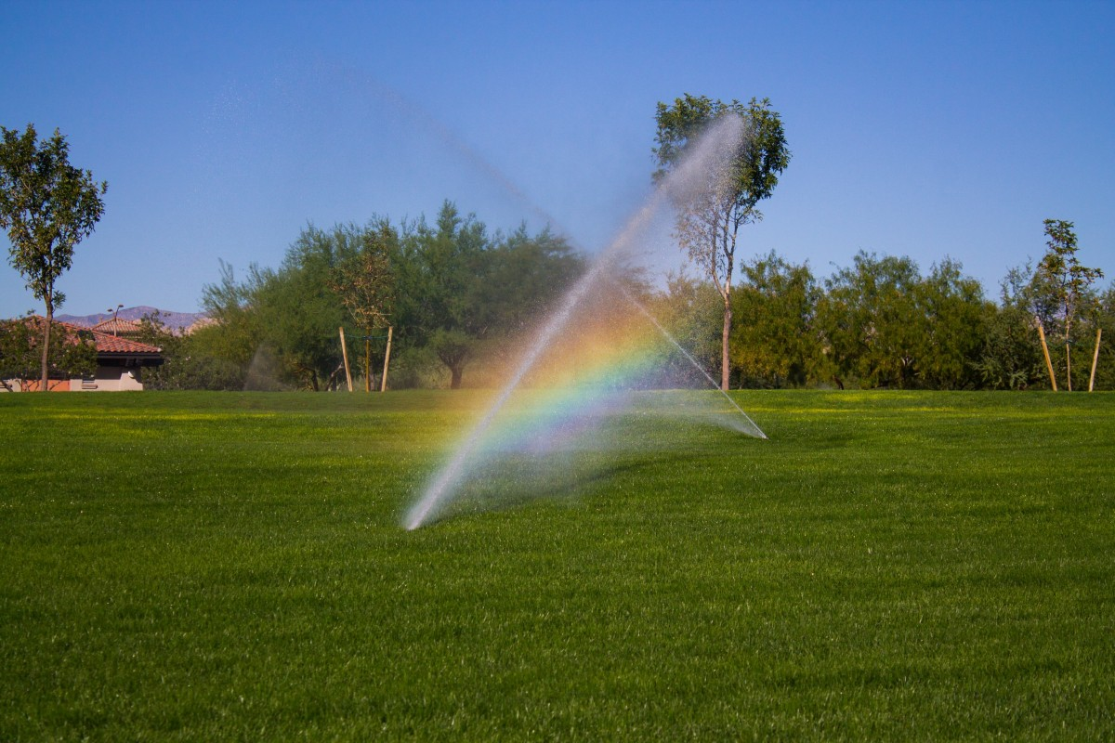
WHAT IS THE PURPOSE OF THIS PROJECT?
One of the major factors in the design, refurbishment and long-term maintenance of any golf course is the way the greens and fairways are watered.
In some golf courses watering systems such as sprinklers or drip water wires are fitted to sprinkle the water automatically and reduce human load.
Here we are proposing an idea of smart sprinkle system where human interaction and remote controlling are combined.

Slide 3
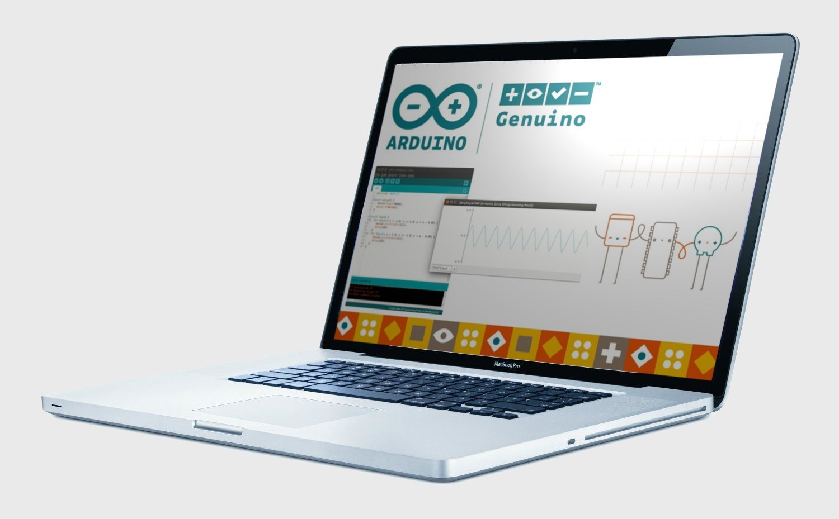
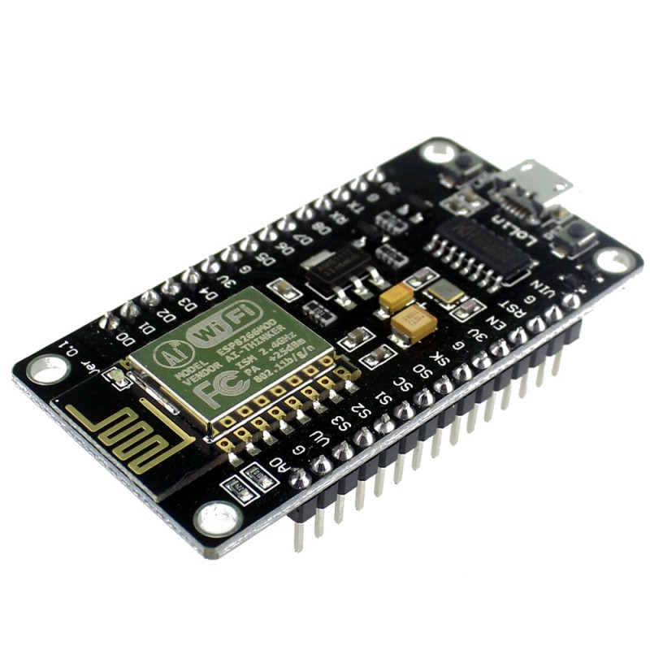
COMPONENTS USED…
HARDWARE COMPONENTS
NodeMCU
Moisture Sensor
Mini Motor pump
SOFTWARE COMPONENTS
Arduino IDE

Slide 4
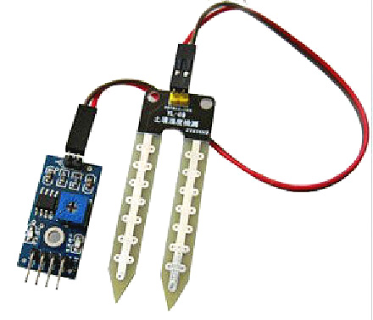
SOIL MOISTURE
Soil moisture is basically the content of water present in the soil.
This can be measured using a soil moisture sensor which consists of two conducting probes that act as a probe. It can measure the moisture content in the soil based on the change in resistance between the two conducting plates.
The resistance between the two conducting plates varies in an inverse manner with the amount of moisture present in the soil.

Slide 5
HOW ARE WE IMPLEMENTING THE PROJECT?
A soil sensor is used which gives the moisture content in the soil.
If the moisture content is below particular level the sprinkler system is turned on manually through mobile app.
Through the web application you can monitor the weather parameters and control the sprinklers of the golf course.

Slide 6
SKILLS WE LEARNT WHILE MAKING THE PROJECT..
1.Environment Skills:
Understanding the climatic variations in the atmosphere
2. Programming Skills:
While making the project we understood how the sensors take in the data we program
3.Thinking Skills:
Thinking about the different ways on to conserve the water and also be user friendly.
4.Team Work

Slide 7
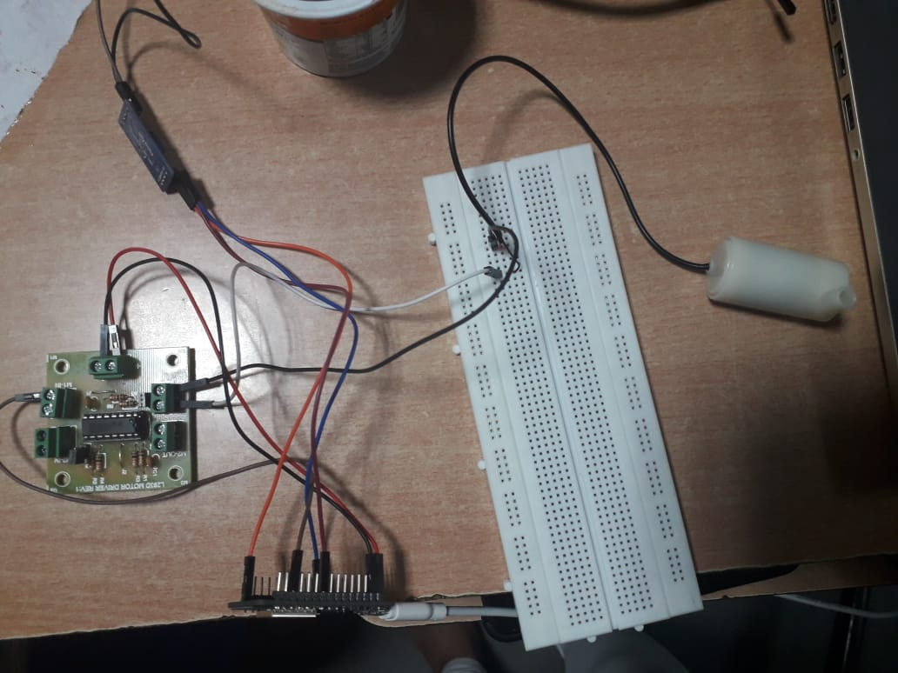
CIRCUIT

Slide 8
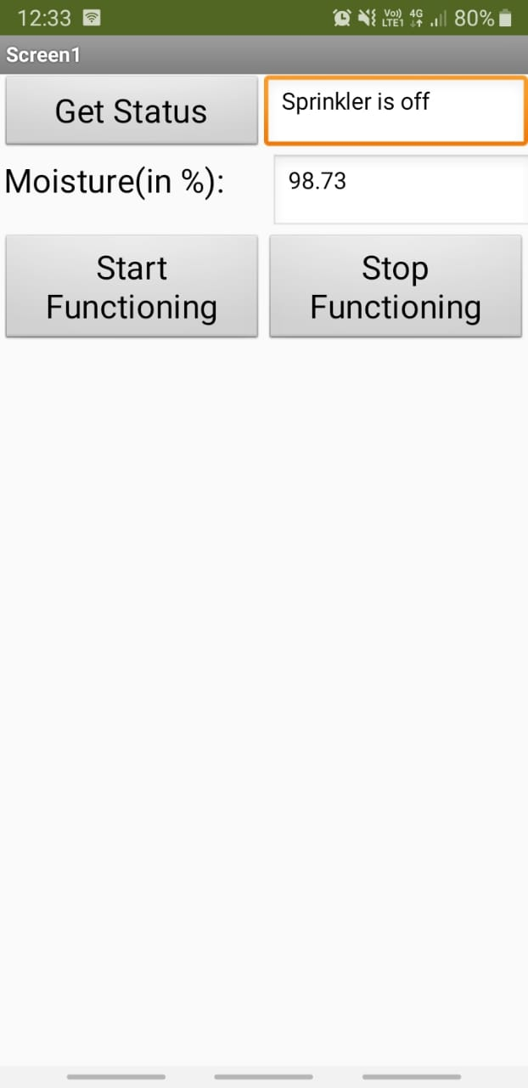

Slide 9
THANK YOU
D. SHREYA
E.HARIKA
P.SNIGDHA

